Slide 1
EV Charging Comparisons
Polar Power EV Direct Charging Solution

Slide 2
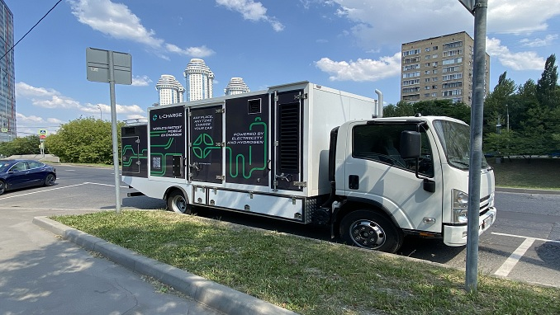
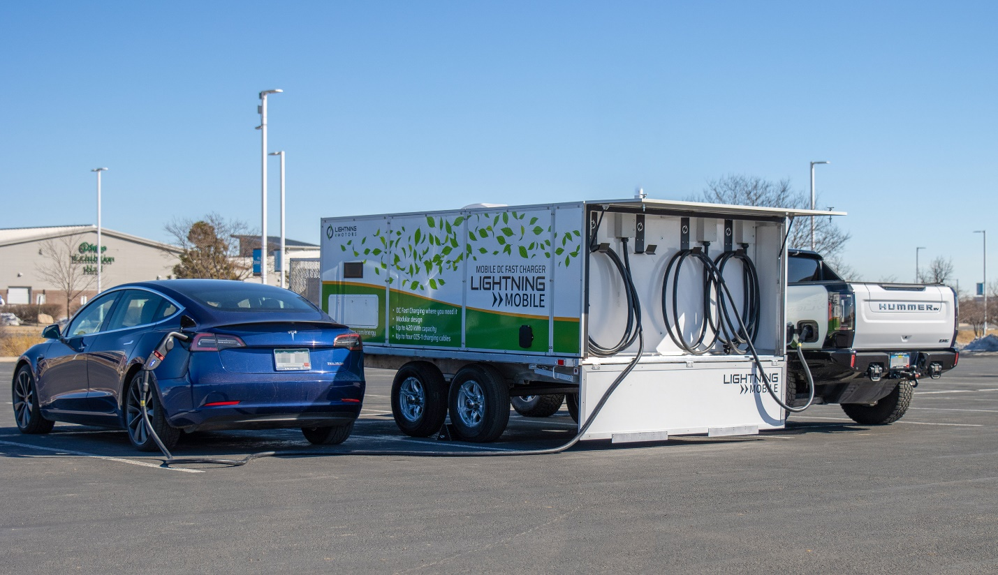
AC Generator to DC Power Supply Charging
Downside:
High fuel usage moving these mobile chargers to the charging site
Additional fuel waste with the energy conversion losses generating AC and having to convert it to DC
Very expensive CAPEX and OPEX
Large size makes it hard to reach stranded vehicles out of charge on highways, freeways, metro areas, parking lots

Slide 3
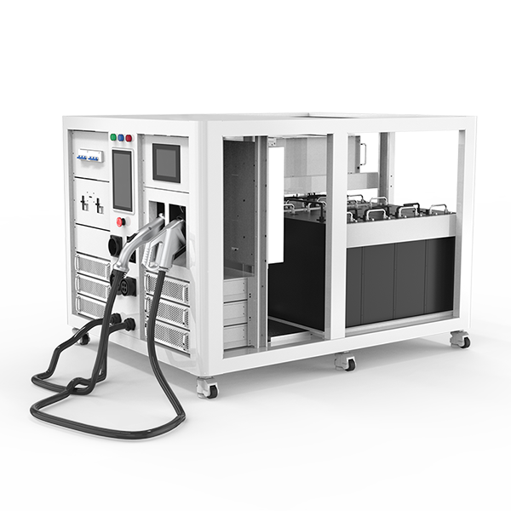
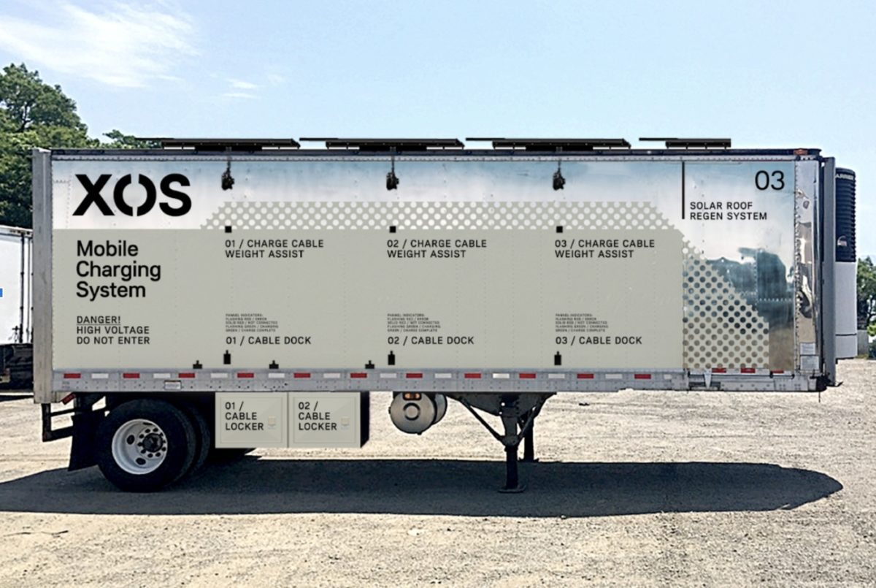
Battery to DC Power Supply Charging
Battery to Battery charging using buck / boost DC power supply. Downside:
When the Battey that supplies the energy for charging need recharging, where do you go? The trailer is too large for a
charging station and it’s very expensive to set up a facility to charge the large trailer as a reasonable rate.
The smaller battery-based unit will have a limited number of EVs it can charges before having to spend an hour or more at a charging station
Large trailer size makes it hard to reach stranded vehicles out of charge on highways, freeways, metro areas, parking lots.
Both the small unit and large trailer have expensive CAPEX and OPEX due to the battery and its replacement costs

Slide 4
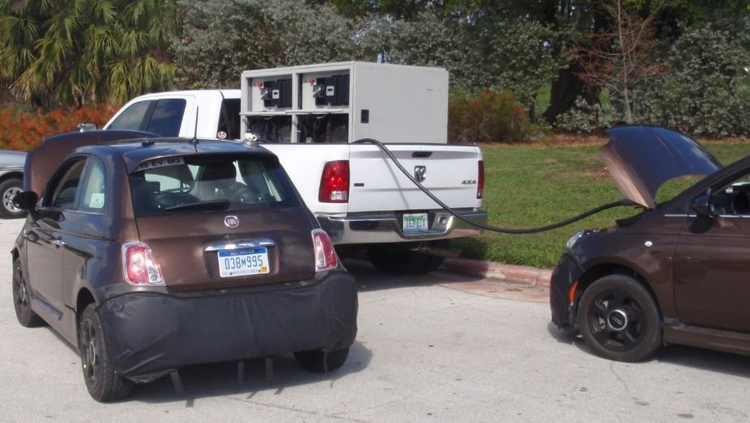
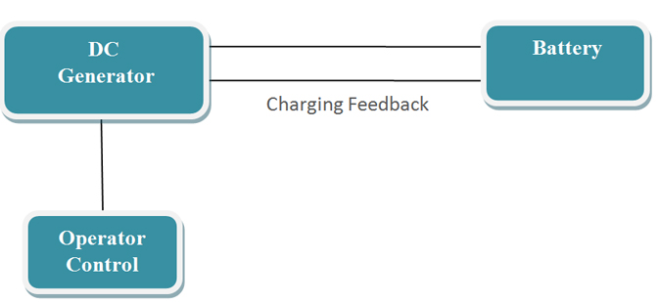
Polar Mobile Rapid Charging System
The Polar Power solution incorporates a DC generator with the necessary controls required to charge the battery directly and automatically. This is the simplest and most efficient solution to providing mobile rapid charging. There are no disadvantages with this approach. Photo shows two separate Polar chargers on the back of a ¾ ton pickup truck. The DC generator can operate on clean fuels such as natural gas and propane, or traditional diesel fuel.
Advantages:
Approx 300 to 370 kg weight for 30kW, level 3 charging
Very compact in size and can fit on a standard tow truck or on the back of a small pickup truck/van
No power conversion electronics is required as charging regulation is accomplished directly through the alternator
Very simple system to maintain and operate, facilitates use with mechanics and tow truck operators
Design for the harsh automotive environments which include corrosion from road salt, rain, marine air, temperature extremes, and road vibration.
Considerably more fuel efficient in converting fuel into battery charging energy than using an AC generator coupled to a battery charger.
This lightweight and compact system saves fuel in transportation
Lowest Cost

Slide 5
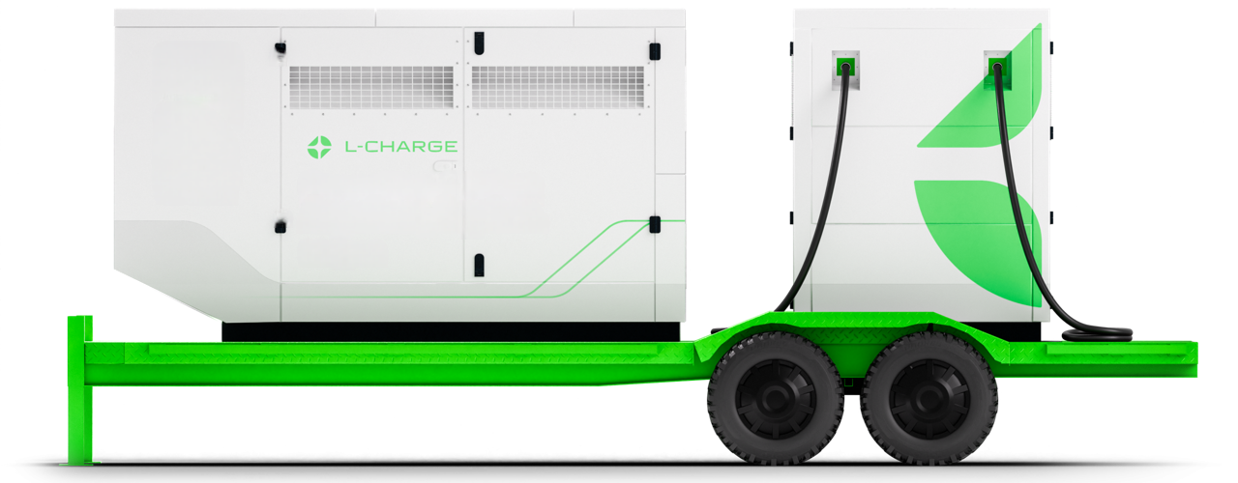
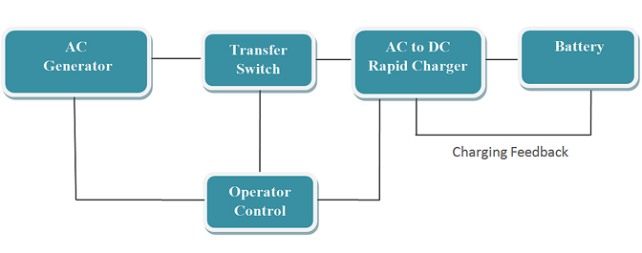
AC Charging Method
Using an AC generator to provide the large power demand required for rapid battery charging through the AC to DC battery charger is a poor solution for this application. There are no advantages with this configuration.
Disadvantages:
1,400 to 2,800 kg weight for 20 kW to 40 kW
Due to large physical size this system requires a dedicated trailer or truck to be mobile as seen in previous slides
Overly complex and more difficult to maintain in harsh environments
Using standard AC rapid chargers is not recommended, as they were not designed for harsh environments and vibration typical of road and highway travel
Considerable fuel is lost in transporting this heavy system
Very High Cost

